Slide 1
CSD 1401
Visual Studio Setup

Slide 2
What you need
Visual Studio Community
Can be found online and free
Use the latest version
CProcessing Library
Found on our moodle page.

Slide 3
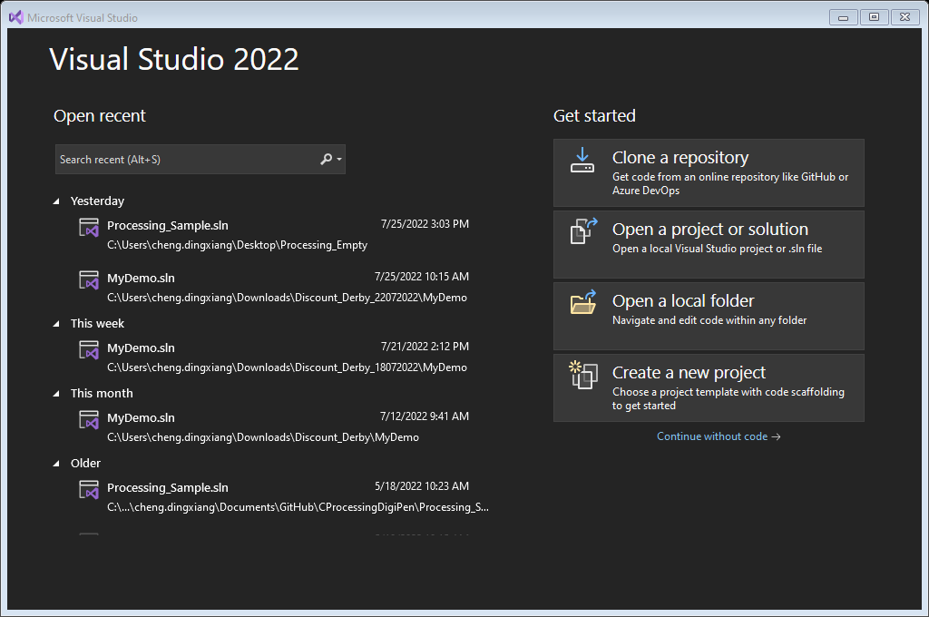
Steps
Launch Visual Studios
Create a new empty project

Slide 4
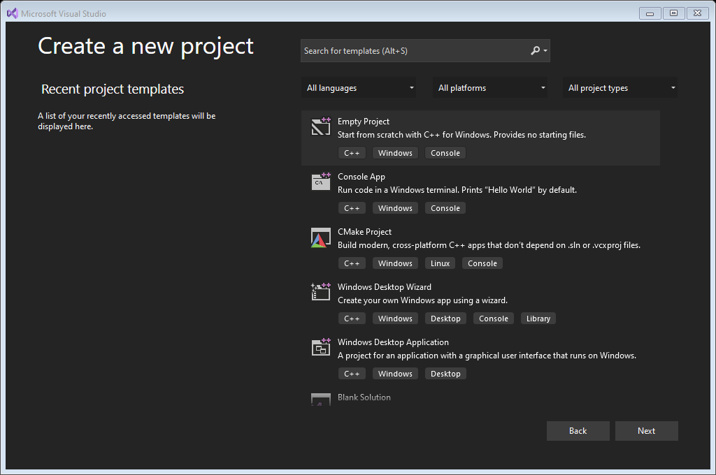
Steps
Launch Visual Studios
Create a new empty project

Slide 5
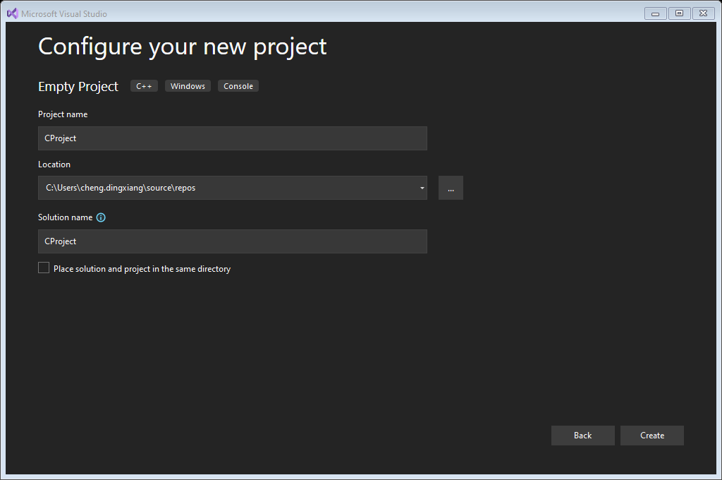
Steps
Choose a name for your project
Choose a location for where the project will reside
We will need to update this folder with some files later, so note where it is.

Slide 6
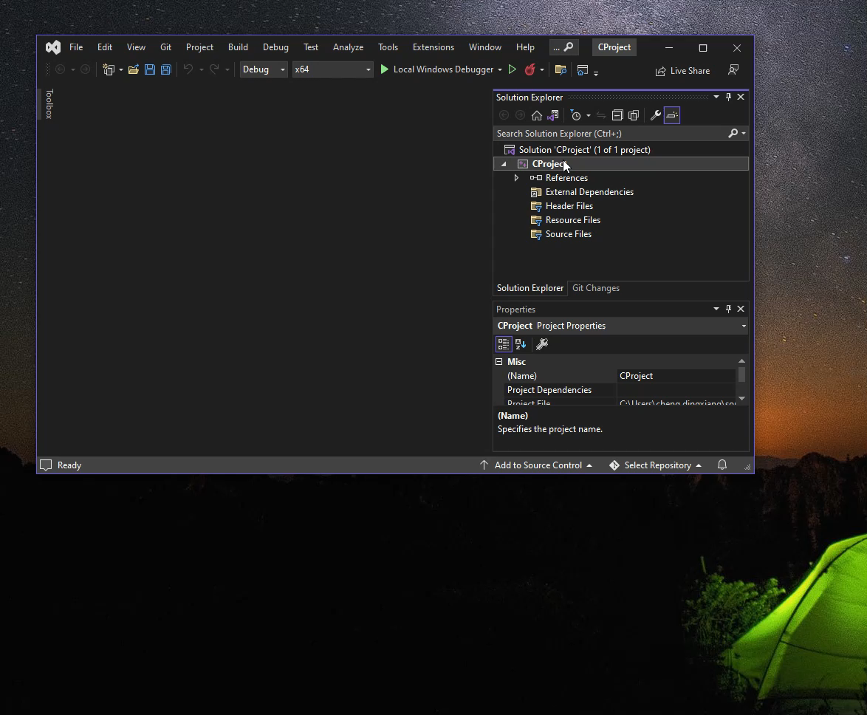
Steps
Right click on the project to find project properties
You will need to edit project properties in the later steps
Within the project properties, find “Configuration Manager”
Remove the “x86” option from the “solution platforms”
This means we will only be developing 64bit software.

Slide 7
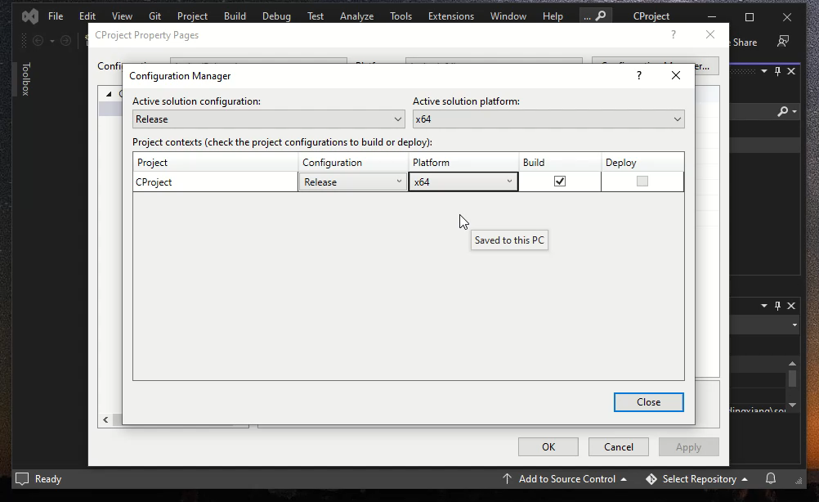
Steps
“Configuration Manager”
Remove “Win32” option from the “Project Platform”

Slide 8
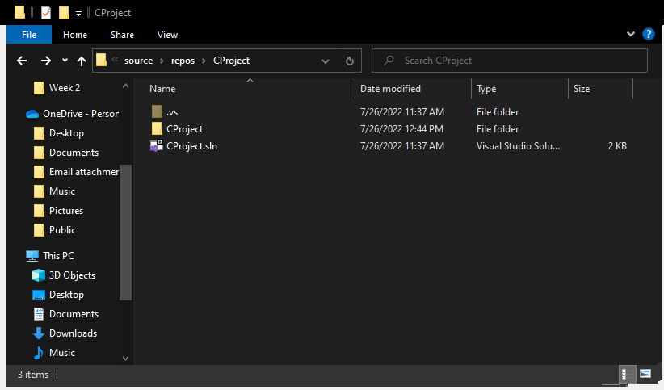
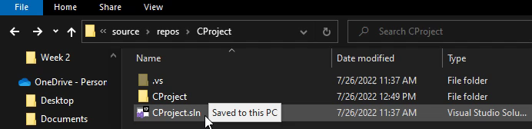
Steps
Let us look at the folder containing the project
If you are unable to see the “.vs” file, click on View->Check the box next to “Hidden Items”
Some hidden items will need to be deleted before you do submissions

Slide 9
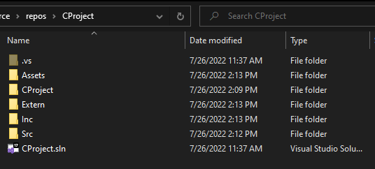
Steps
Create the following folders in this directory
Src : For .c files
Inc: For .h files
Extern: For CProcessing files
Assets: For textures, audio and other data files

Slide 10
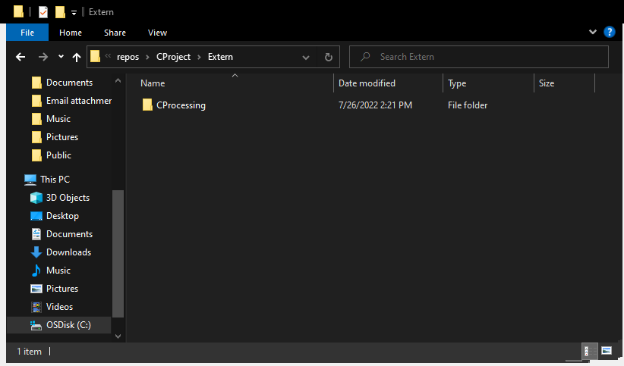
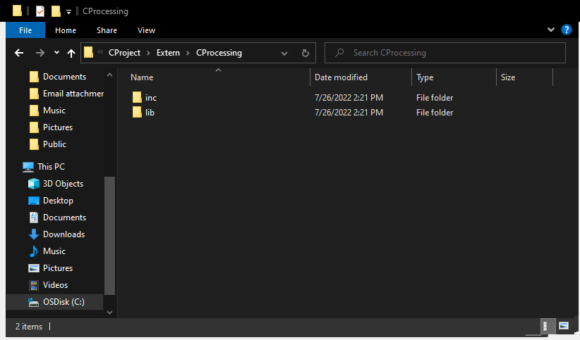
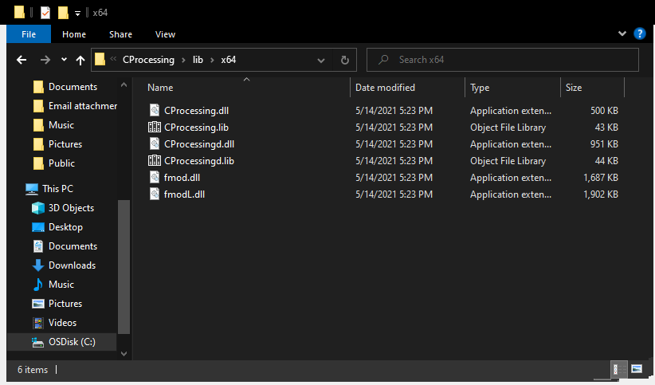
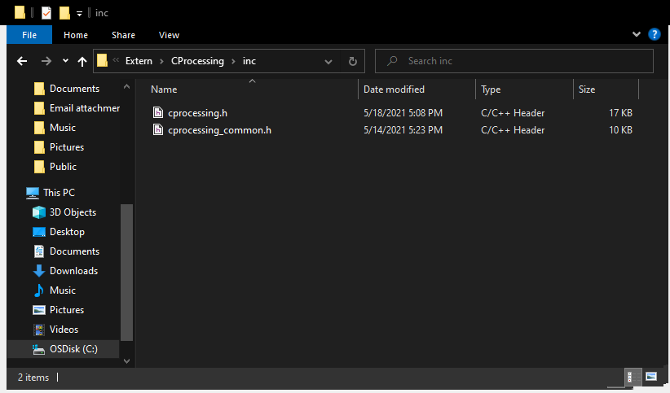
Steps
Copy “CProcessing” folder into “Extern” folder
Get the library from moodle
Contents of your Cprocessing folder should be as follows ->

Slide 11
Linking lib&inc of CProcessing to solution
Back to Visual Studio
For “Configuration” set to “All Configurations”
In “Configuration Properties->VC++ Directories”, ADD the following:
Include Directories: $(SolutionDir)Extern\CProcessing\inc
Library Directories: $(SolutionDir)Extern\CProcessing\lib\x64
This links the lib and inc files to the project

Slide 12
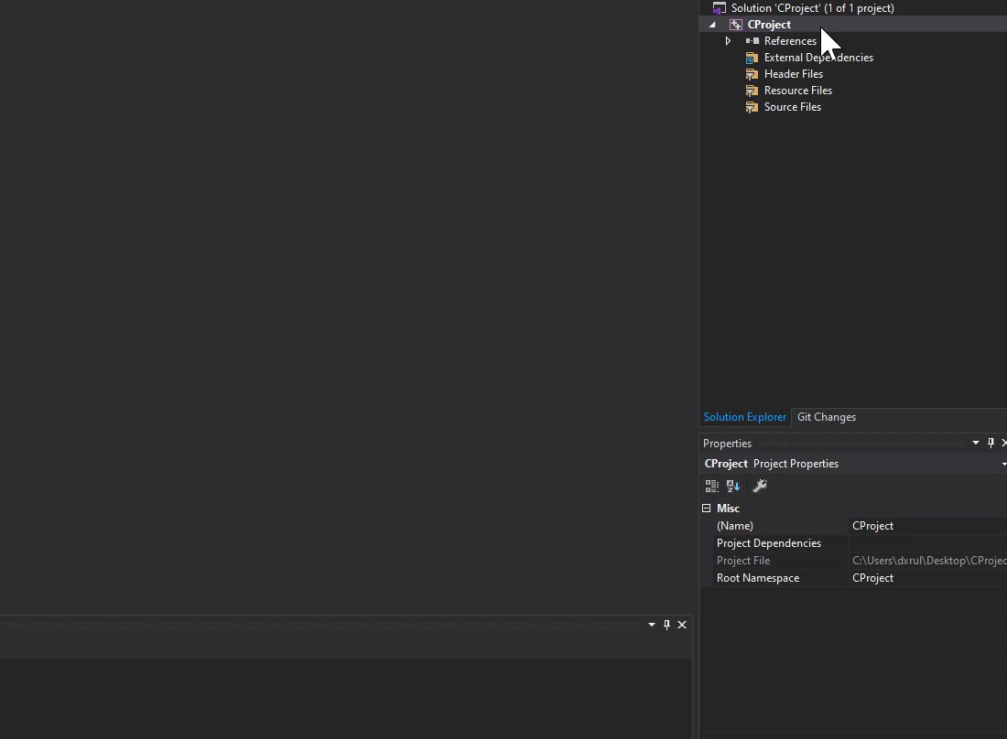

Slide 13
Steps
For “Configuration” set to “All Configurations”
In “Configuration Properties->Advanced->Character Set”
“Use Mutli-Byte Character Set”

Slide 14
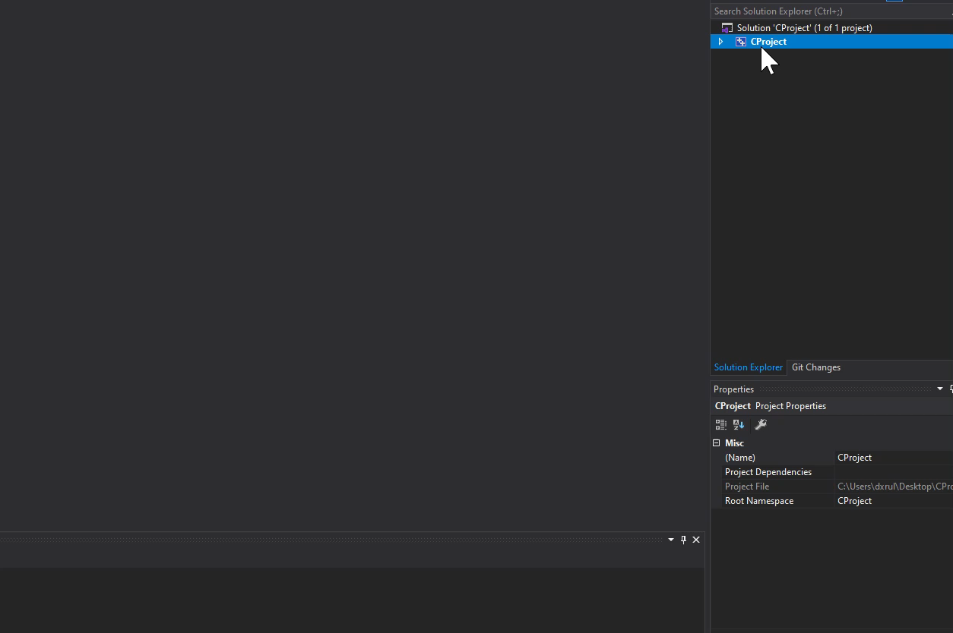

Slide 15
Complying with CProcessing Entry Point
For “Configuration” set to “All Configurations”
In “Configuration Properties->Linker>Advanced>Entry Point”
“mainCRTStartup”

Slide 16
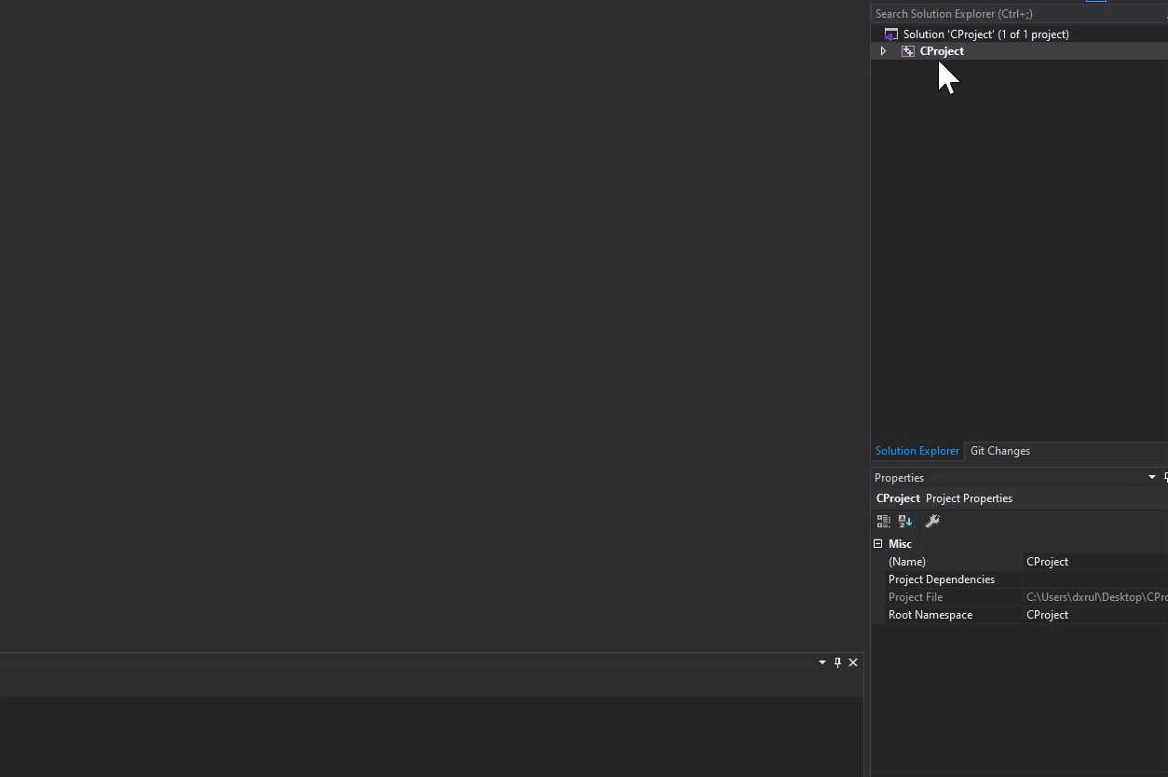

Slide 17
Choosing directories for work
For “Configuration” set to “All Configurations”
In “Configuration Properties->Output Directory”
$(SolutionDir)bin\$(Configuration)-$(Platform)\
In “Configuration Properties->Intermediate Directory”
$(SolutionDir).tmp\$(Configuration)-$(Platform)\
For “Configuration” set to “Debug”
In “Configuration Properties->Debugging- Working Directory”
$(SolutionDir)bin\$(Configuration)-$(Platform)\
(the video shows the wrong text entry for this part)

Slide 18
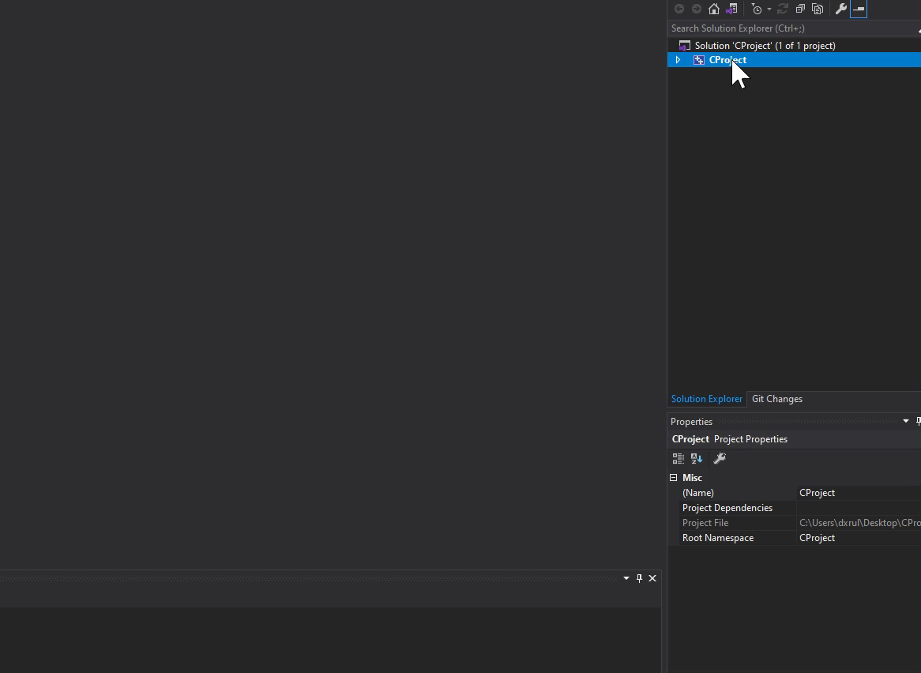

Slide 19
Linking Dependencies
For “Configuration” set to “Release”
In “Configuration Properties->Linker->Input->Additional Dependencies”
Add “CProcessing.lib”
For “Configuration” set to “Debug”
In “Configuration Properties->Linker->Input->Additional Dependencies”
Add “CProcessingd.lib”
Notice the “d” in this one

Slide 20
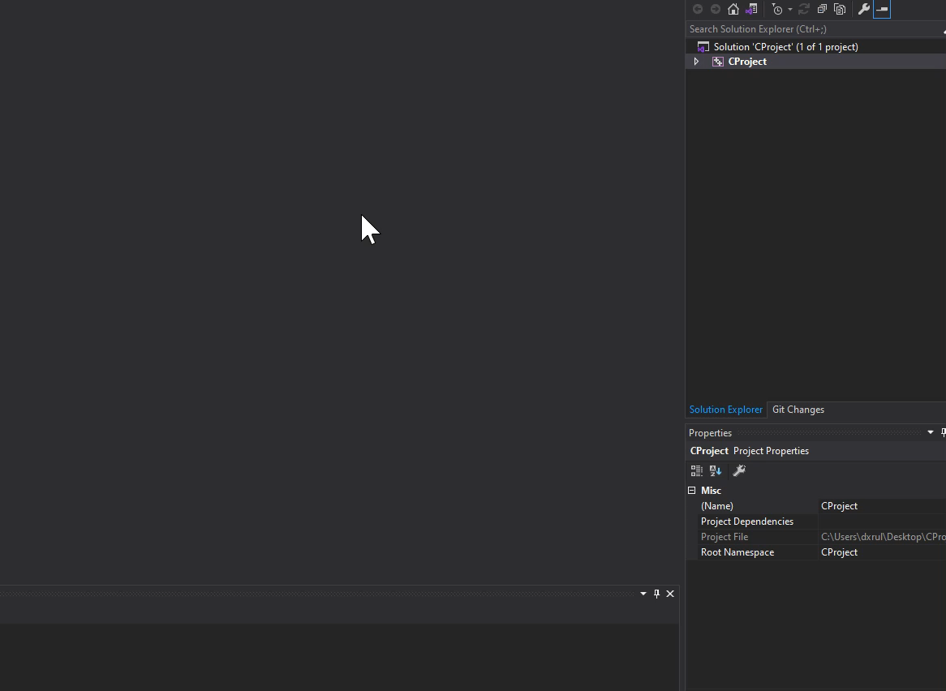

Slide 21
Copying Assets and libraries to output dir
For “Configuration” set to “Debug”
In “Configuration Properties->Build Events->Post-Build Event”
xcopy "$(SolutionDir)Extern\CProcessing\lib\x64\CProcessingd.dll" "$(OutDir)" /s /r /y /q
xcopy "$(SolutionDir)Extern\CProcessing\lib\x64\fmodL.dll" "$(OutDir)" /s /r /y /q
xcopy "$(SolutionDir)Assets\*" "$(OutDir)Assets\" /s /r /y /q
(The video uses ProjectDir instead of SolutionDir. SolutionDir is the correct one)

Slide 22
Copying Assets and libraries to output dir
For “Configuration” set to “Release”
In “Configuration Properties->Build Events->Post-Build Event”
xcopy "$(SolutionDir)Extern\CProcessing\lib\x64\CProcessing.dll" "$(OutDir)" /s /r /y /q
xcopy "$(SolutionDir)Extern\CProcessing\lib\x64\fmod.dll" "$(OutDir)" /s /r /y /q
xcopy "$(SolutionDir)Assets\*" "$(OutDir)Assets\" /s /r /y /q
(The video uses ProjectDir instead of SolutionDir. SolutionDir is the correct one)

Slide 23
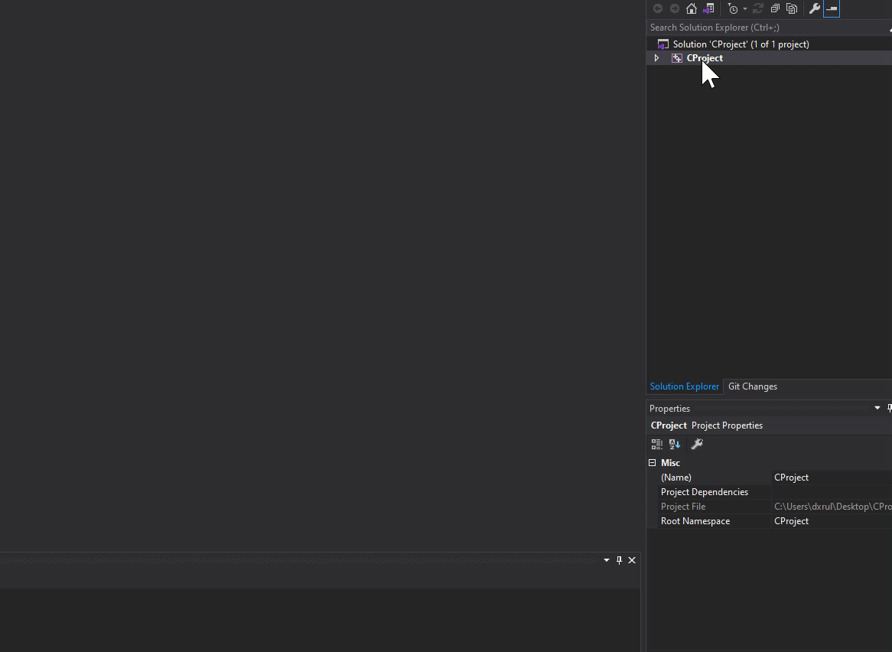
Example

Slide 24
Subsystem
For “Configuration” set to “All Configurations”
In “Configuration Properties->Linker>System->SubSystem”
“Windows(/SUBSYSTEM:WINDOWS)”
You may set the Subsytem to console to use “printf” for debugging
This should be set to Windows for submission.

Slide 25
Testing
Add the given “main.c” to your “Src” folder
Add the given “DigiPen_Singapore_WEB_RED.png” to your “Assets” folder
Add “main.c” into your solution

Slide 26
